Slide 1
Electrical Service Design of a 10 Storeyed 2 Unit Apartment Building
Submitted By
1806164-Zafrin Jahan Nikita
1806167-Moytri Ghosal
1806168-Sandipa Chowdhury
1806172-Sudipto Pramanik
1806173-Sadia Tasnim Mou
1806179-Protoye Kumar Mohanta
1806190-Rudmila Rahman

Slide 2
Steps of the Design Procedure
Layout Design (Typical Floor , Ground Floor, Basement, Rooftop)
Fixture Calculation
Fixture Placement
Conduit Calculation
Conduit Placement (Emergency + Main lines)
Circuit Diagram Calculation
Circuit Diagram Placement

Slide 3


Steps of the Design Procedure
Fixture Calculation
For no of lights
For no of fans
N =$L∗\frac{W}{100}$

Slide 4
Steps of the Design Procedure
Conduit Calculation
Symbol | Wire Rating (single core)-mm² | Current Rating (ampere) | GI Pipe Diameter (inch)
C1 | 2x1.5 | 5A | ¾
C2 | 4x1.5 | 5A | ¾
C3 | 6x1.5 | 5A | ¾
C4 | 8x1.5 | 5A | ¾
C5 | 10x1.5 | 5A | 1
C6 | 12x1.5 | 5A | 1
C7 | 14x1.5 | 5A | 1
C8 | 2x4+4 ECC | 15A | 1
C9 | 2x6+6 ECC | 20A | 1

Slide 5
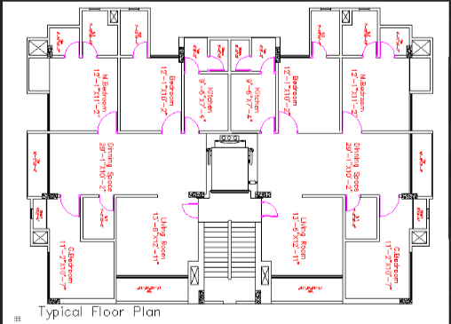
Steps of the Design Procedure
Layout Design (Typical Floor)

Slide 6
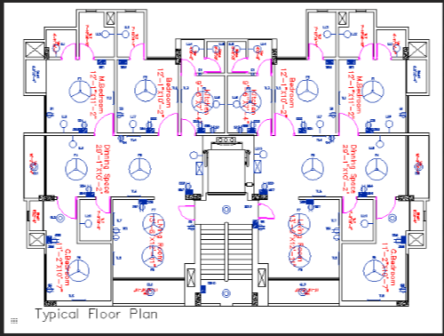
Steps of the Design Procedure
Fixture Placement(Typical Floor with fixture)

Slide 7
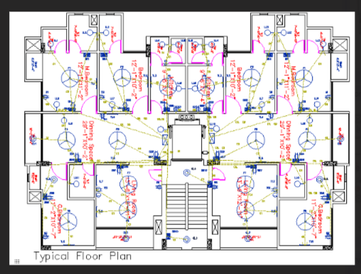
Steps of the Design Procedure
Conduit Placement (Typical Floor with main lines)

Slide 8
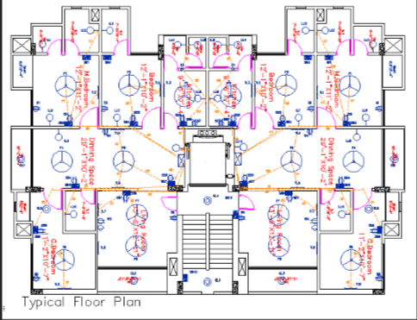
Steps of the Design Procedure
Conduit Placement (Typical Floor with emergency lines)

Slide 9
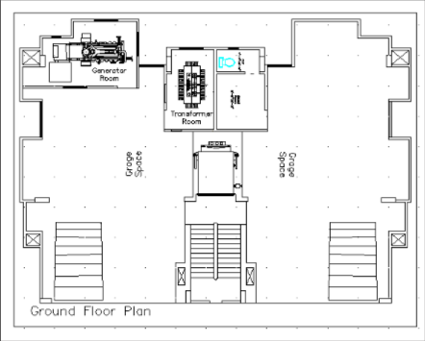
Steps of the Design Procedure
Layout Design (Ground Floor )

Slide 10
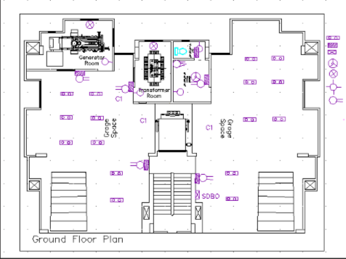
Steps of the Design Procedure
Fixture Placement (Ground Floor with fixture )

Slide 11
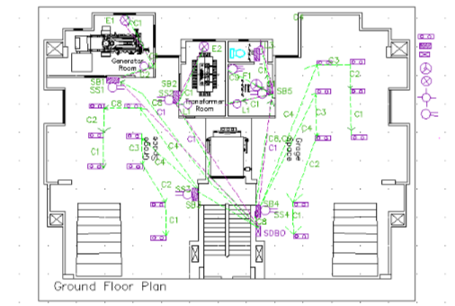
Steps of the Design Procedure
Conduit Placement (Ground Floor with conduit)

Slide 12
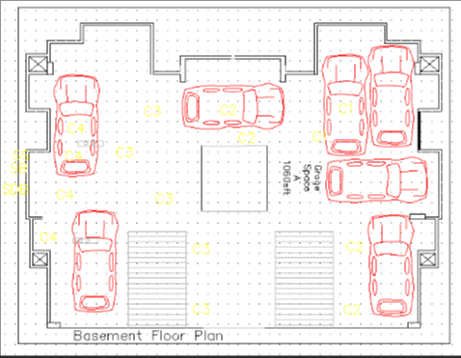
Steps of the Design Procedure
Layout Design (Basement)

Slide 13
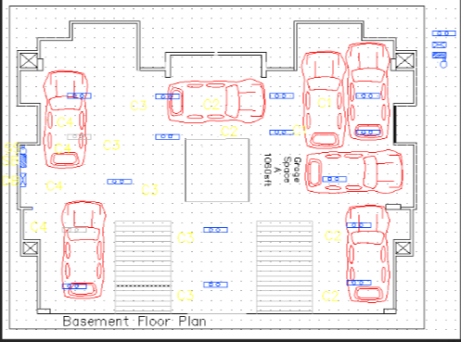
Steps of the Design Procedure
Fixture Placement (Basement with fixture)

Slide 14
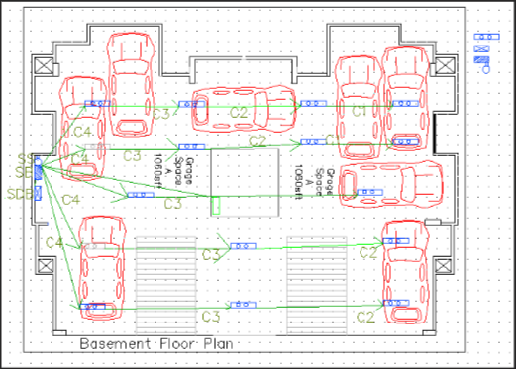
Steps of the Design Procedure
Conduit Placement (Basement with conduit)

Slide 15
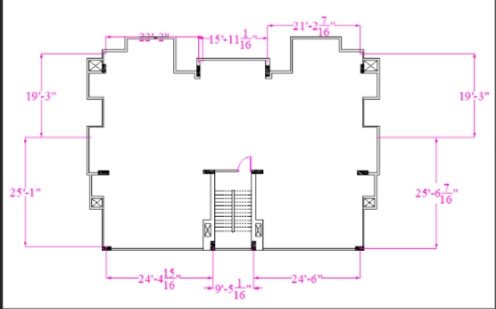
Steps of the Design Procedure
Layout Design (Rooftop)

Slide 16
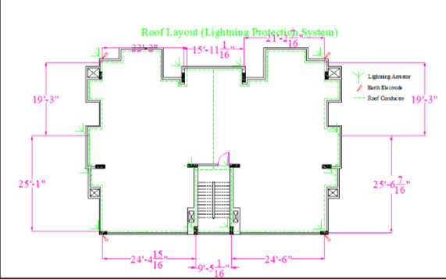
Steps of the Design Procedure
Layout Design (Rooftop with other settings)

Slide 17
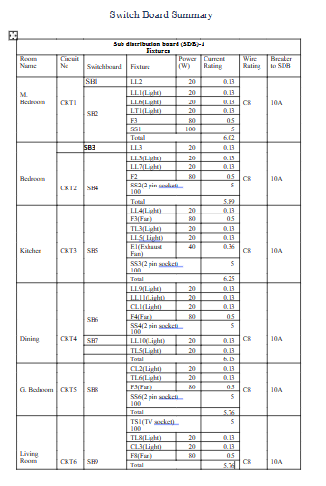
Steps of the Design Procedure
Circuit Diagram Calculation
(Typical floor)

Slide 18
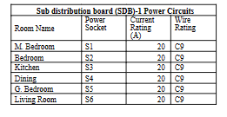
Steps of the Design Procedure
Circuit Diagram Calculation (Typical floor)

Slide 19
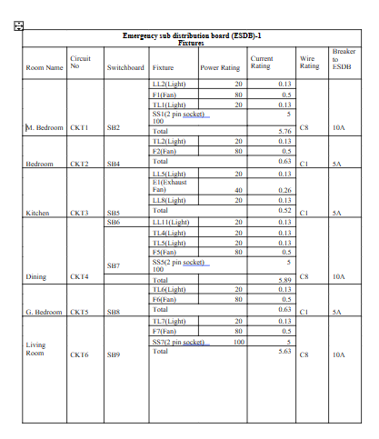
Steps of the Design Procedure
Circuit Diagram Calculation
(Typical floor)

Slide 20

Steps of the Design Procedure
Circuit Diagram Calculation (Ground floor)

Slide 21
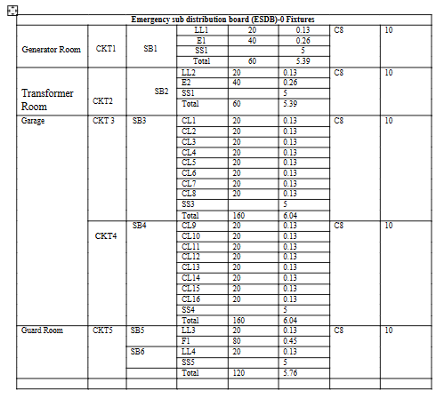
Steps of the Design Procedure
Circuit Diagram Calculation (Ground floor)

Slide 22
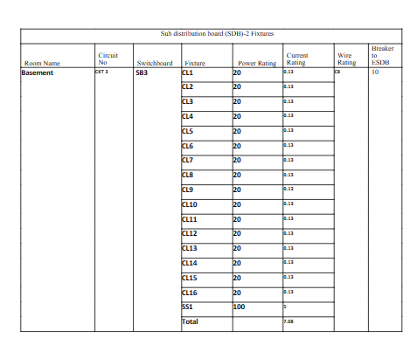
Steps of the Design Procedure
Circuit Diagram Calculation (Ground floor)

Slide 23
Steps of the Design Procedure
Circuit Diagram Calculation (Basement)

Slide 24
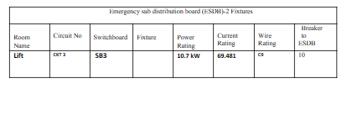
Steps of the Design Procedure
Circuit Diagram Calculation (Basement)

Slide 25
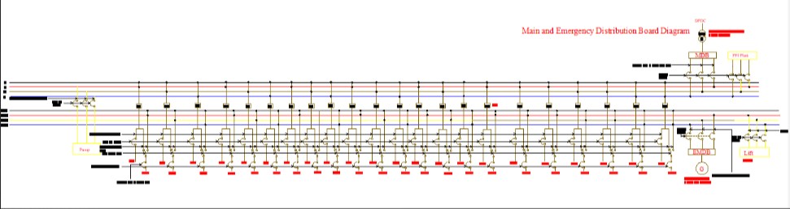
Steps of the Design Procedure
Circuit Diagram Placement

Slide 26
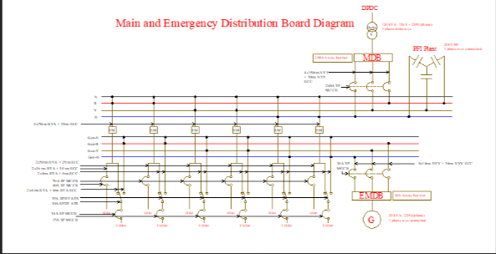
Steps of the Design Procedure
Circuit Diagram Placement (Main and Emergency Distribution Board Diagram)

Slide 27
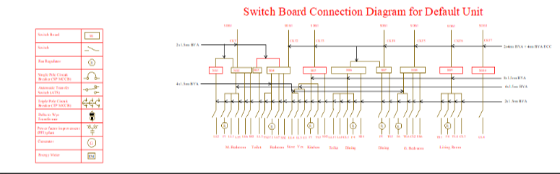
Steps of the Design Procedure
Circuit Diagram Placement

Slide 28
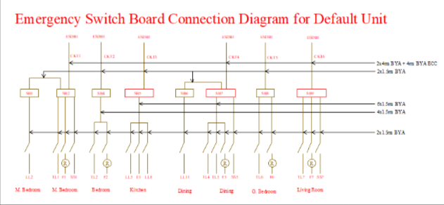
Steps of the Design Procedure
Circuit Diagram Placement

Slide 29
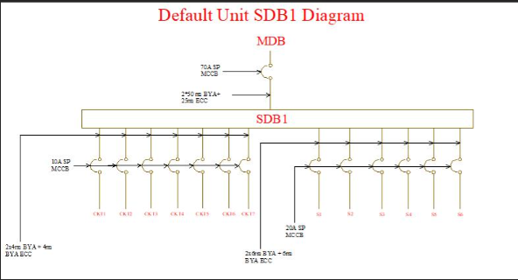
Steps of the Design Procedure
Circuit Diagram Placement

Slide 30
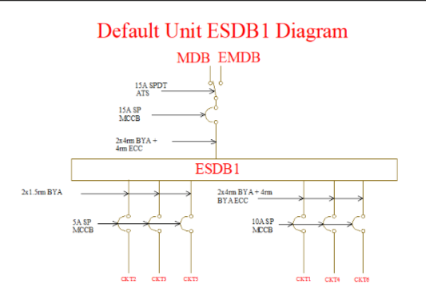
Steps of the Design Procedure
Circuit Diagram Placement

Slide 31
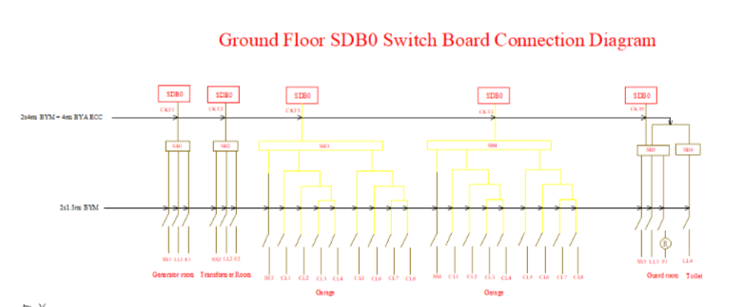
Steps of the Design Procedure
Circuit Diagram Placement

Slide 32
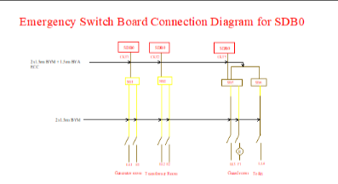
Steps of the Design Procedure
Circuit Diagram Placement

Slide 33
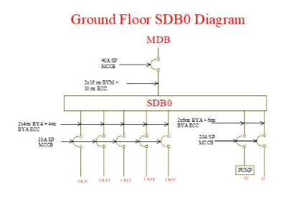
Steps of the Design Procedure
Circuit Diagram Placement

Slide 34
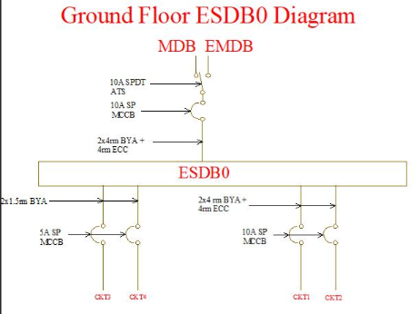
Steps of the Design Procedure
Circuit Diagram Placement

Slide 35
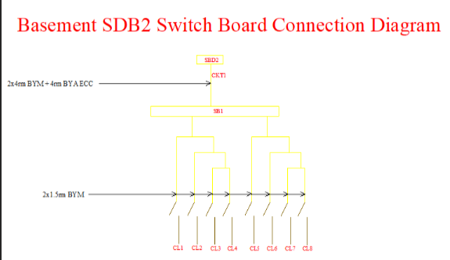
Steps of the Design Procedure
Circuit Diagram Placement

Slide 36
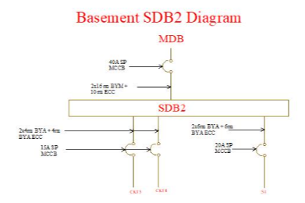
Steps of the Design Procedure
Circuit Diagram Placement

Slide 37
Contribution
1806164, 1806172, 1806173: Circuit Diagram, Overall Calculation
1806167, 1806168, 1806179: Ground Floor, Wiring, Fixture Placement and Calculation
1806172, 1806190: Typical floor, Basement, Rooftop, Ground Floor (Transformer and Generator Room)

Slide 38
Thank You!

